Slide 1


NGT Engagement Program
Make it real.

Slide 2
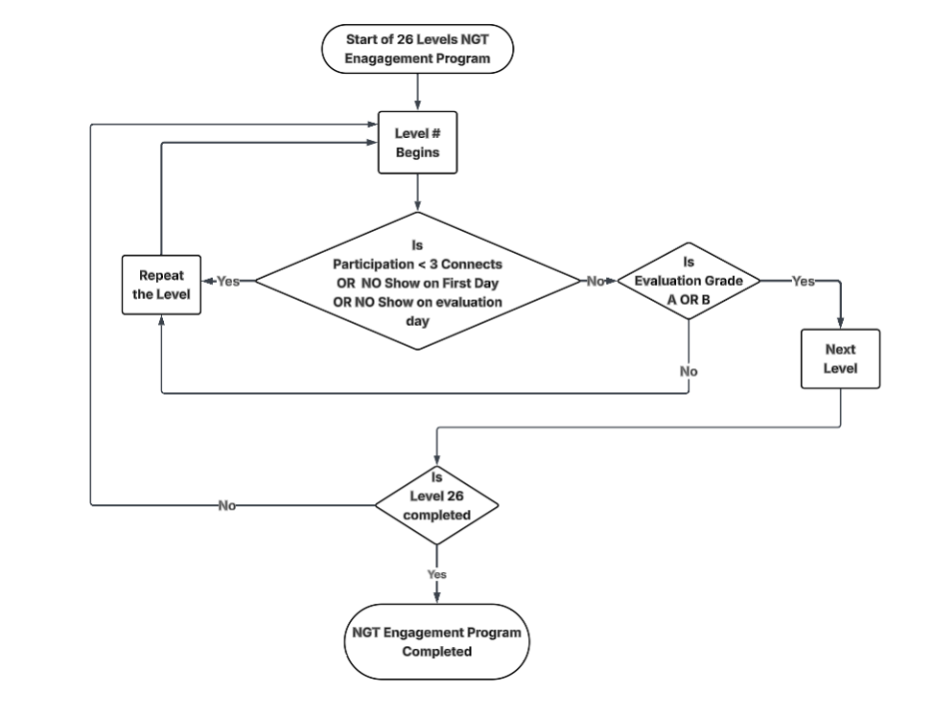

Slide 3
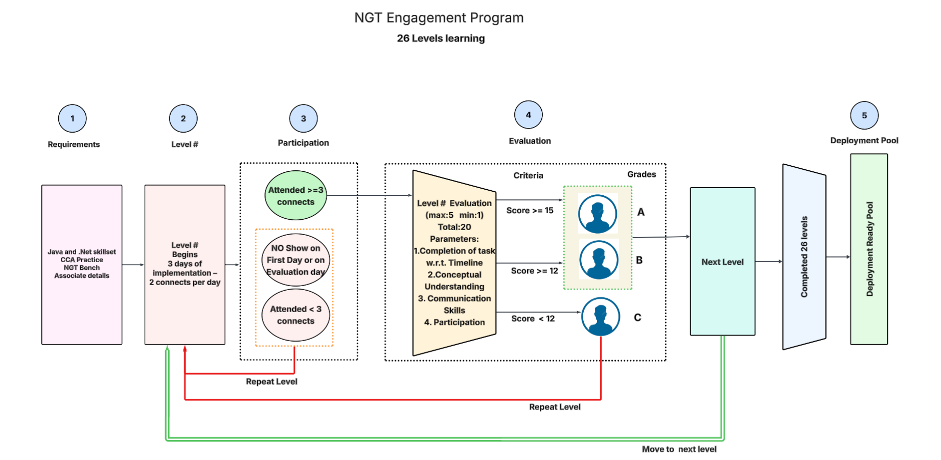

Slide 4
Level Info
Azure Repos
Class Design
Banking Service – Collaborative Repo Challenge-Arrays-TDD
Banking Service – Collaborative Repo Challenge-Collections-Mockito
Game Scheduler
Exception Library
Milestone_1
Exhibit Moniter-Part 1
Exhibit Moniter-Part 2
AWS AI Certifivation
AWS AI Self study week-1
AWS AI Selt study week-2
OCEAN certification
Udemy HTTP Course completion
HR assessment
Servlet
Hands On –On -JPA

Slide 5
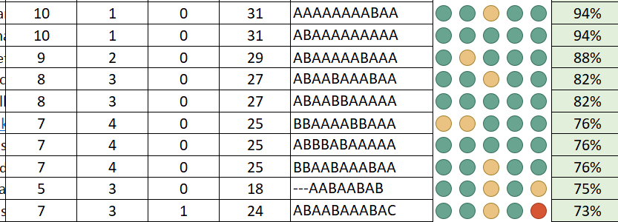
Profiling Sample

Slide 6
Back cover

